Slide 1
ECEN 350 Electronic Devices and Circuits
Bipolar Junction Transistors

Slide 2
ECEN 350 – Topics
Semiconductor Physics
IC Op-Amps
Rectifiers
Zeners
Diodes
BJTs
MOSFETs
CMOS
LEDs
Transistor Biasing
Small-Signal Analysis
Amplifier Gain Stages
Frequency Response

Slide 3
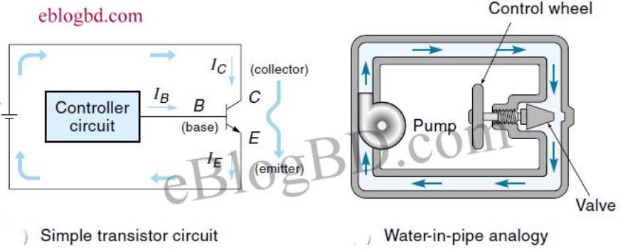
Transistor – Electronic Valve
A Transistor is an electronic valve controlling the flow of current.
We cover two different types of transistors in ECEN 350: 1. Bipolar Junction Transistors. 2. MOSFETs.
Bipolar Junction Transistors (BJTs) have three terminals:
Base.
Emitter.
Collector.

Slide 4
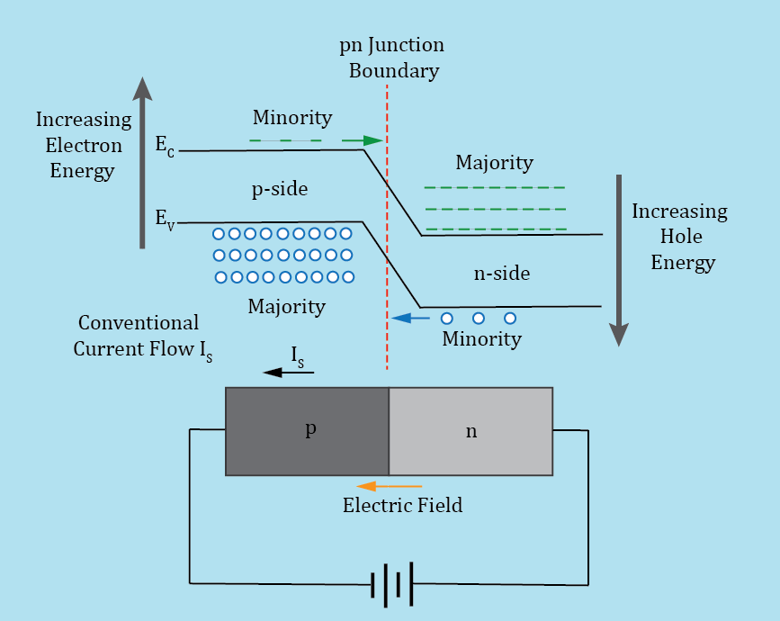
pn Junction Diode – Reverse Bias
With reverse bias, more work is required to move conduction
band electrons from the n-side to the p-side.
Reverse bias widens the depletion region and increases the
barrier potential between the n and p-side of the junction.
For a reverse biased pn junction, the depletion region inhibits
majority carriers from crossing the junction, while aiding minority
carriers to cross the junction.
A relatively small conventional current, referred to as reverse
saturation current I_{s}, flows in a reversed biased pn junction diode.
I_{s} consists mostly of minority carriers in the vicinity of the depletion
region crossing the junction. Saturation refers to the fact that I_{s}
reaches a maximum value under reverse bias, only slightly increasing with increasing reverse voltage.
For a typical silicon pn junction diode at 25˚C , I_{s} << 1 µA.

Slide 5
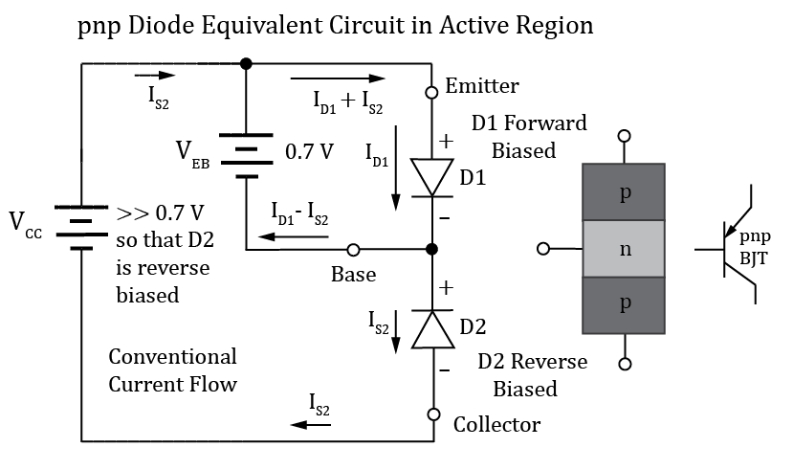
pnp Diode Equivalent Circuit
For matched silicon pn junction diodes we expect I_{S2} to be much less than I_{D1}.
How can we make I_{S2} larger than the typically negligible reverse saturation current?
Diode D1 is injecting holes, i.e., minority carriers, into n-type cathode region of D2. Remember that for a reverse biased pn junction, the depletion region inhibits majority carriers from crossing the junction, while aiding minority carriers to cross the junction.
By narrowing the width of the n-type region we inject minority carriers in the vicinity of the reverse biased pn junction of diode D2, which will increase I_{S}. Also, utilizing a lightly doped n-type region widens the D2 depletion region extension into the n-type base region, further increasing I_{S}.
The bias conditions shown with D1 forward biased and D2 reverse biased is referred to as the Active Region of operation.

Slide 6
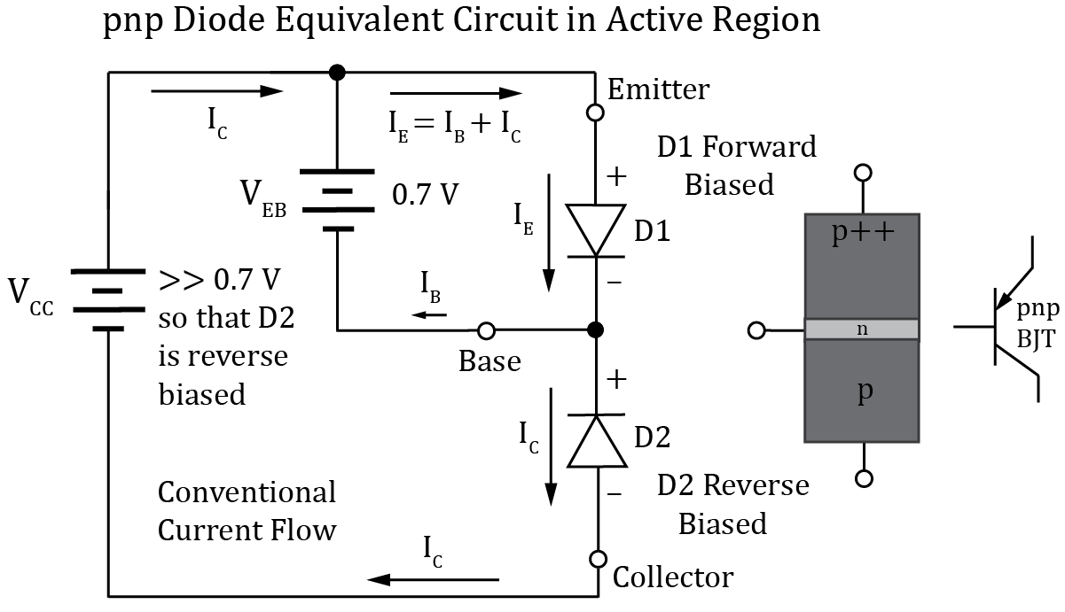
pnp Diode Equivalent Circuit (Continued)
Bipolar junction transistors utilize a very narrow and lightly doped base region in order to increase I_{S2}, referred to as collector current I_{C}. This works surprisingly well as I_{C} >> I_{B} for the standard bipolar junction transistors operating in the active region. Almost all of the holes from D1 injected into D2 cross the reversed D2 junction and end up as collector current, rather than base current.
The result of this non-intuitive approach is an electronic device in which the collector current I_{C} is controlled by a much smaller base current I_{B}, providing the desired goal of an electronically controlled current flow.
If the Base-Emitter diode, diode D1 in the above pictorial, is not forward biased, then the bipolar junction transistor simply behaves as an open switch between emitter and collector, which is also a useful function.
The p++ emitter region simply indicates heavy doping with respect to the other regions.

Slide 7
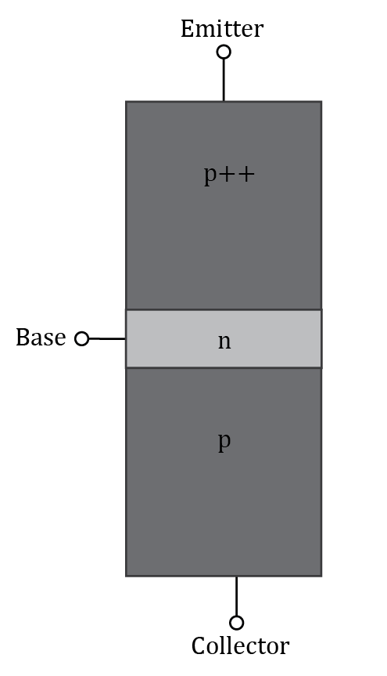
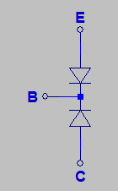
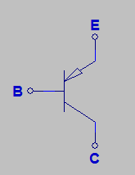
pnp Bipolar Junction Transistor
p++ emitter region in above diagram indicated heavy doping with respect to the other regions
Bipolar meaning two pn junctions. Want the Base-Emitter junction in the above transistor forward biased to turn on transistor, else it behaves like an open switch between the emitter and collector.
Actual width of narrow base is < 1 % of overall transistor width.
pnp Diode Equivalent Circuit
pnp Schematic Symbol

Slide 8
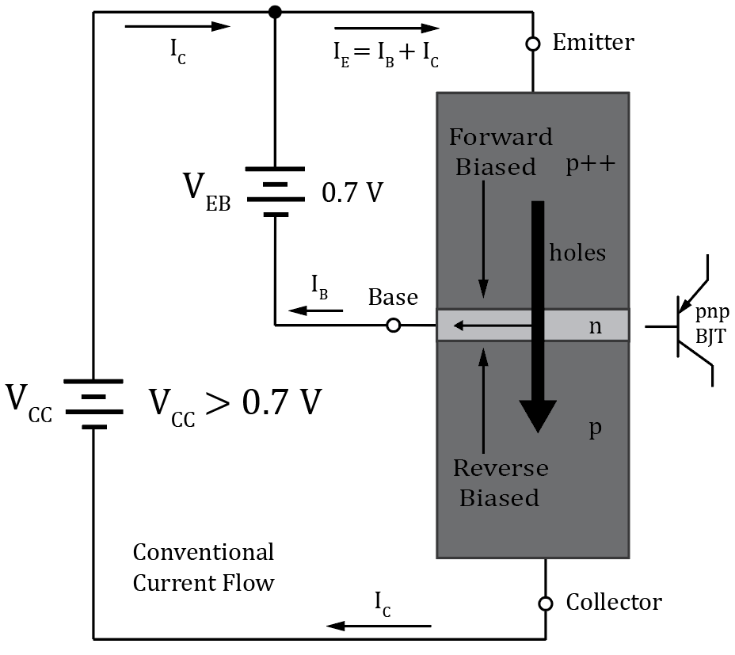
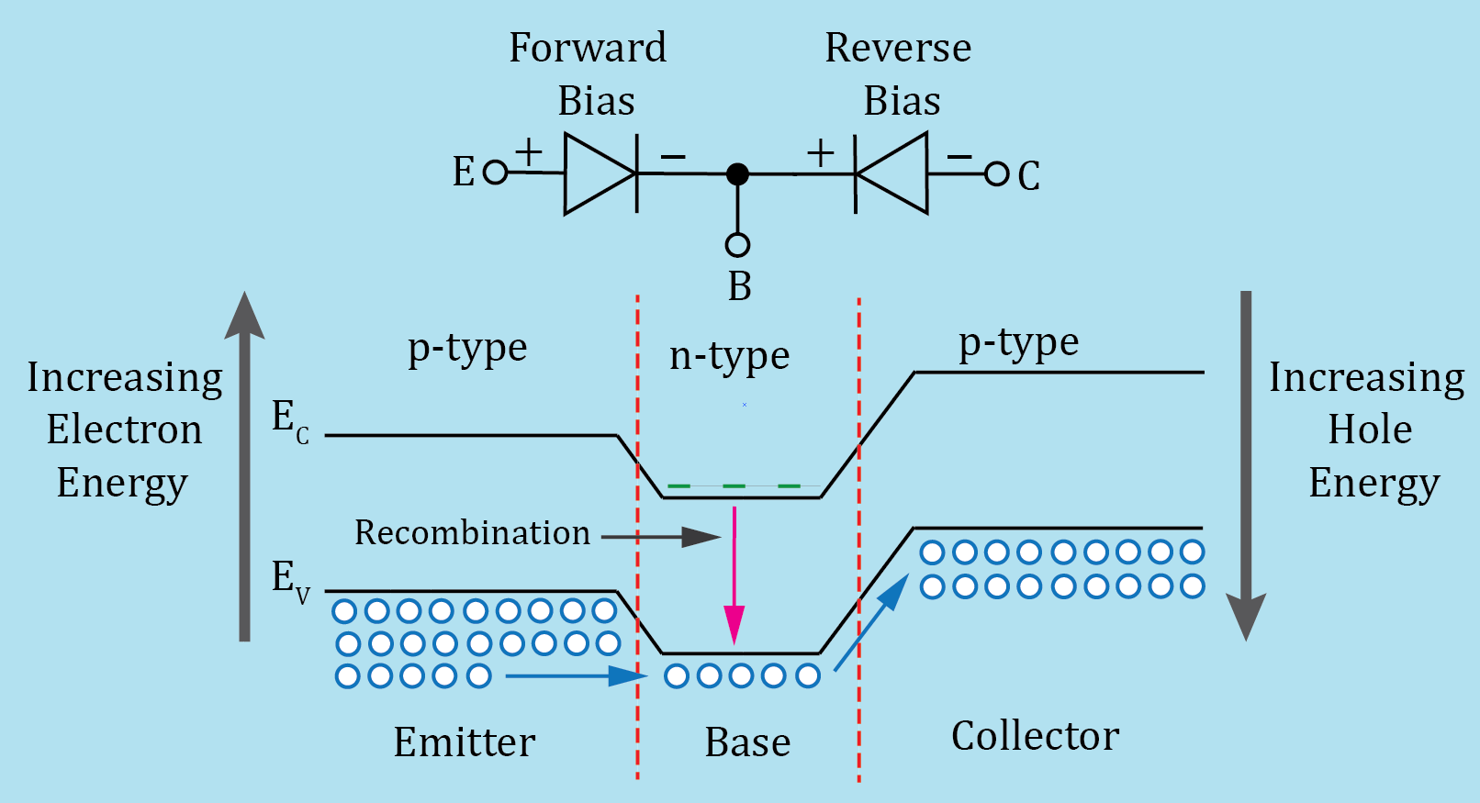
pnp Active Region Operation
For active region want Base-Emitter
junction forward biased with Collector-Base junction reverse biased.
Forward biased Base-Emitter junction results in a large number of holes injected into in the n-type base. Because of the Emitter and Base doping disparity, these holes can actually outnumber the conduction band (CB) electrons, yet since they are holes in an n-type region, they are still considered minority carriers.
pn junctions inhibit majority carriers from crossing, while aiding the crossing of minority carriers.
Almost all holes injected from Emitter to Base end up in the Collector.
pnp Energy Band Diagram in Active Region

Slide 9
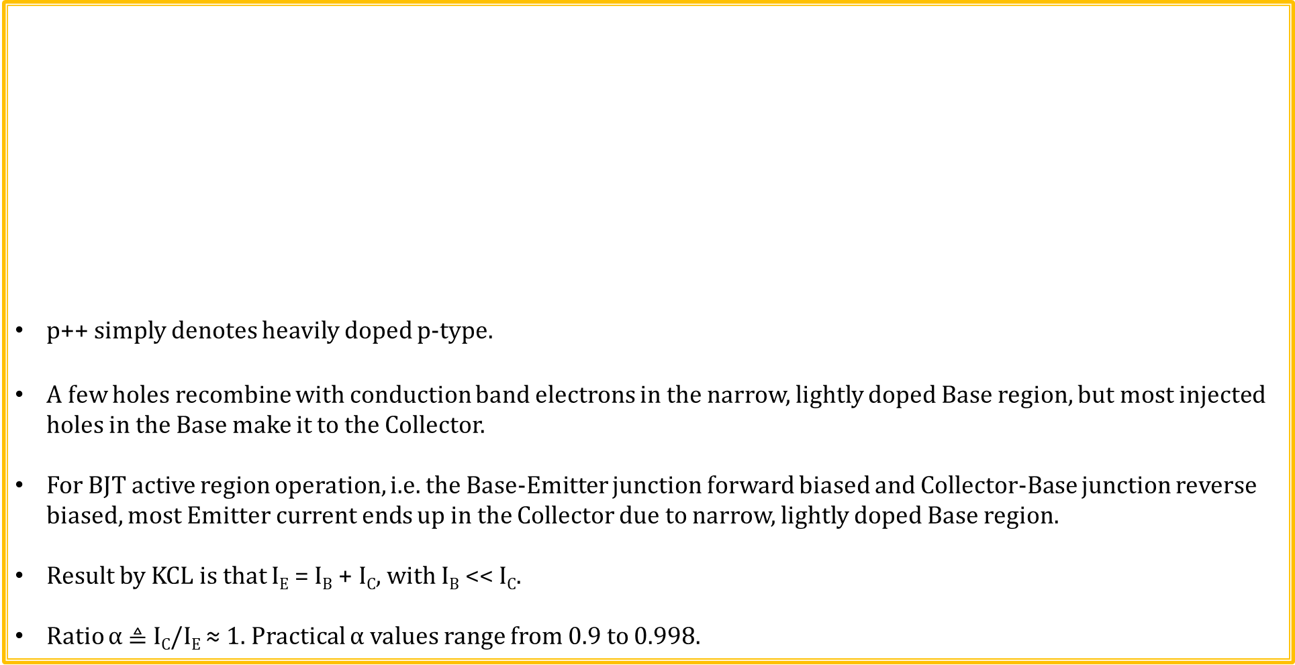
pnp Active Region Operation (Continued)
p++ simply denotes heavily doped p-type.
A few holes recombine with conduction band electrons in the narrow, lightly doped Base region, but most injected holes in the Base make it to the Collector.
For BJT active region operation, i.e. the Base-Emitter junction forward biased and Collector-Base junction reverse biased, most Emitter current ends up in the Collector due to narrow, lightly doped Base region.
Result by KCL is that I_{E} = I_{B} + I_{C}, with I_{B} << I_{C}.
Ratio α $≜$ I_{C}/I_{E} ≈ 1. Practical α values range from 0.9 to 0.998.
pnp Energy Band Diagram in Active Region

Slide 10
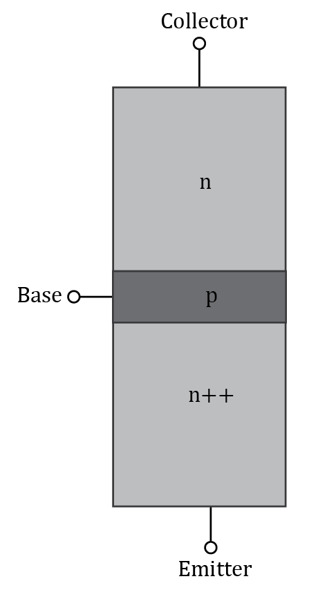
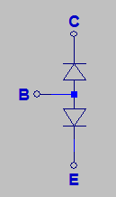
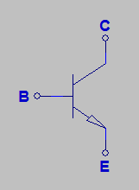
npn Bipolar Junction Transistor
n++ emitter region in above diagram indicated heavy doping with respect to the other regions
Bipolar meaning two pn junctions. Want Base-Emitter junction in the above transistor forward biased to turn on transistor, else it behaves like an open switch between the collector and emitter.
Actual width of narrow base is < 1 % of overall transistor width.
npn Diode Equivalent Circuit
npn Schematic Symbol

Slide 11
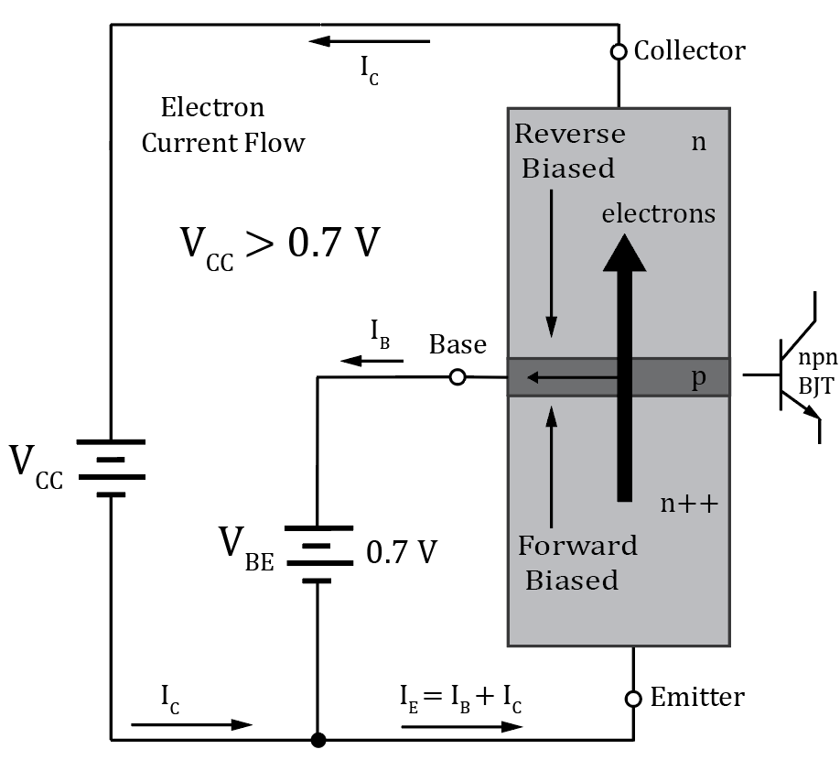
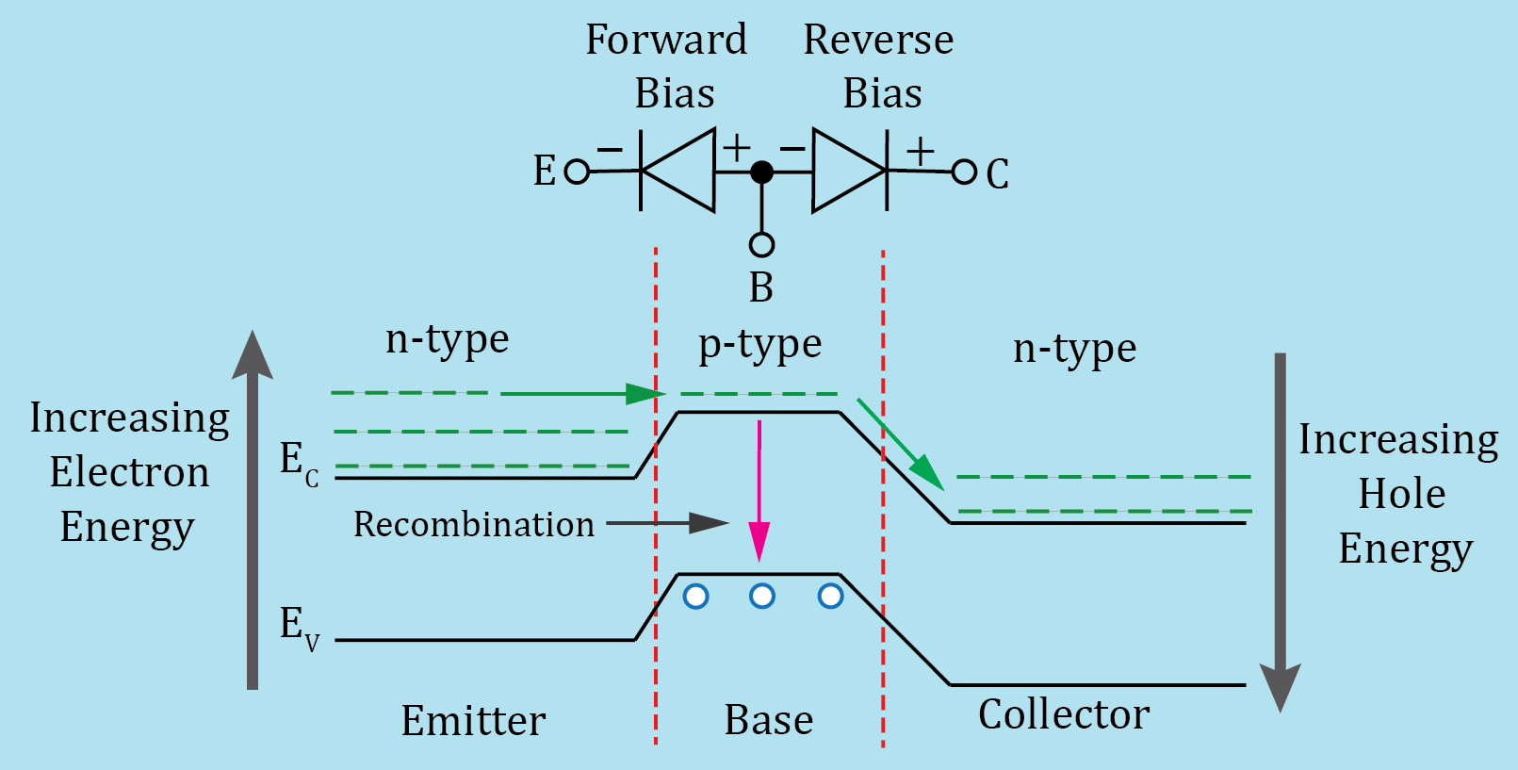
npn Active Region Operation
Use electron versus conventional current flow for above npn pictorial.
For active region want Base-Emitter junction forward biased with Collector-Base junction reverse biased.
Forward biased Base-Emitter junction results in a large number of CB electrons injected into in the p-type base. Because of the Emitter and Base doping disparity, these CB electrons can actually outnumber the valence band holes, yet since they are CB electrons in a p-type region, they are still considered minority carriers.
Almost all conduction band electrons injected from Emitter to the Base end up in the Collector.
npn Energy Band Diagram in Active Region

Slide 12
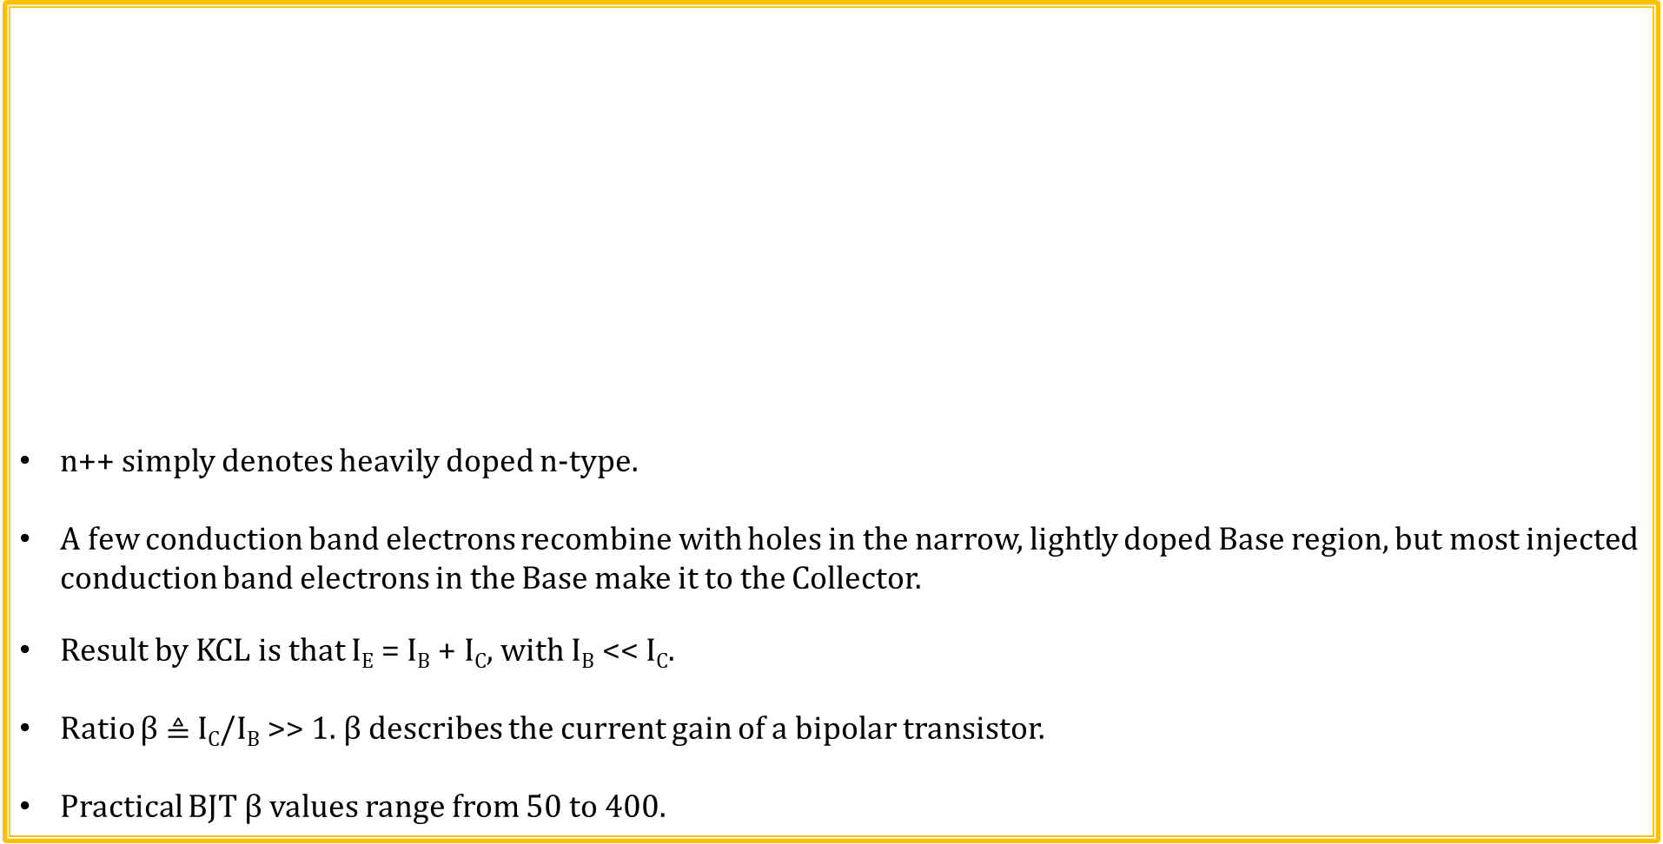
npn Active Region Current Flow (Continued)
n++ simply denotes heavily doped n-type.
A few conduction band electrons recombine with holes in the narrow, lightly doped Base region, but most injected conduction band electrons in the Base make it to the Collector.
Result by KCL is that I_{E} = I_{B} + I_{C}, with I_{B} << I_{C}.
Ratio β $≜$ I_{C}/I_{B} >> 1. β describes the current gain of a bipolar transistor.
Practical BJT β values range from 50 to 400.
npn Energy Band Diagram in Active Region

Slide 13
npn Active Region Current Flow (Continued)
Why do most injected conduction band electrons in the p-type Base region cross the reversed biased pn junction and end up in the Collector?
Because there is relatively little recombination in the lightly doped Base region, so the overwhelming number of “minority carrier” fall down the energy hill to the Collector.
Remember that for reverse biased pn junctions, the depletion region inhibits majority carriers from crossing the junction, while aiding minority carriers to cross the junction.
Conduction band electrons injected into the p-type Base are still considered minority carrier, even though they may outnumber the number of valence band holes (Majority Carriers) in the Base region.
npn Energy Band Diagram in Active Region

Slide 14
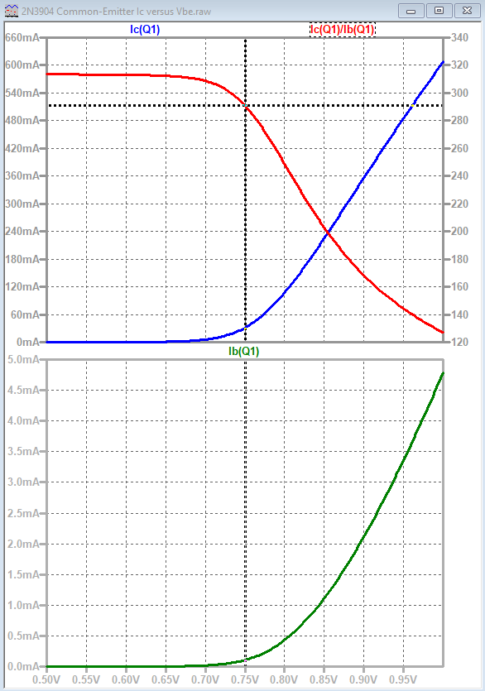
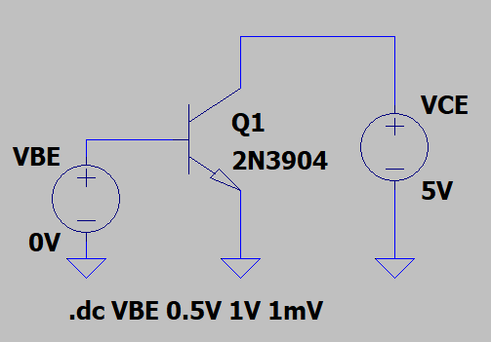
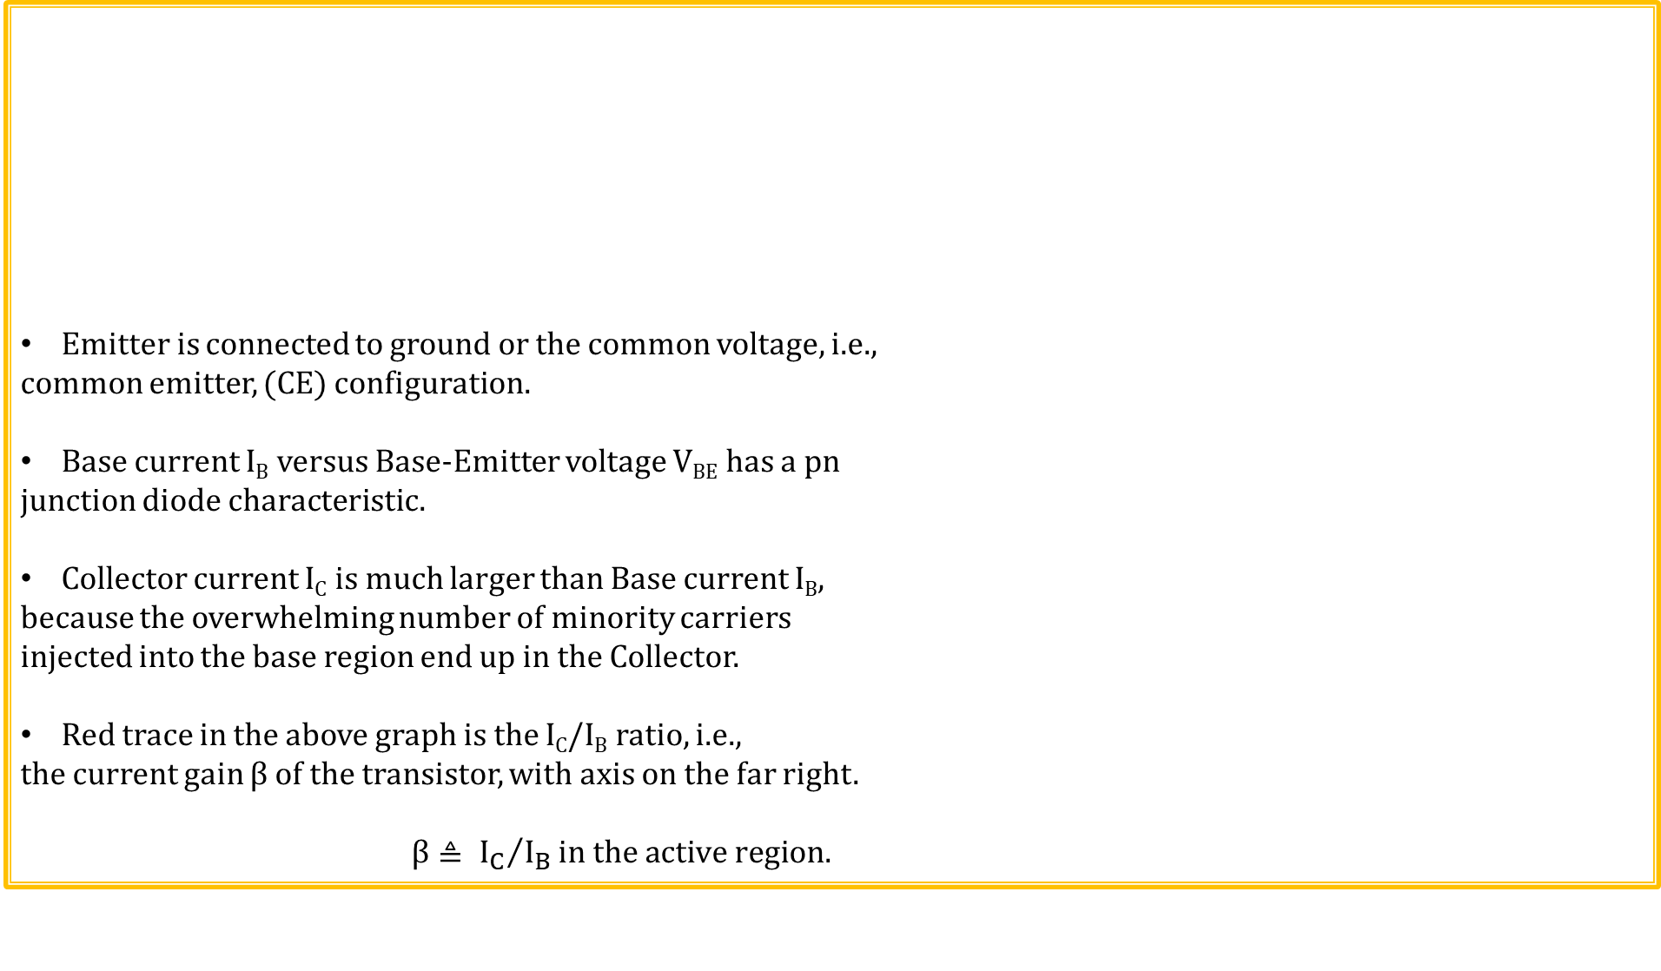
npn Common-Emitter (CE) I-V Characteristics
Emitter is connected to ground or the common voltage, i.e.,
common emitter, (CE) configuration.
Base current I_{B} versus Base-Emitter voltage V_{BE} has a pn
junction diode characteristic.
Collector current I_{C} is much larger than Base current I_{B},
because the overwhelming number of minority carriers
injected into the base region end up in the Collector.
Red trace in the above graph is the I_{C}/I_{B} ratio, i.e.,
the current gain β of the transistor, with axis on the far right.
$\text{β}≜ {I_{C}}/{I_{B}}in the active region.$

Slide 15
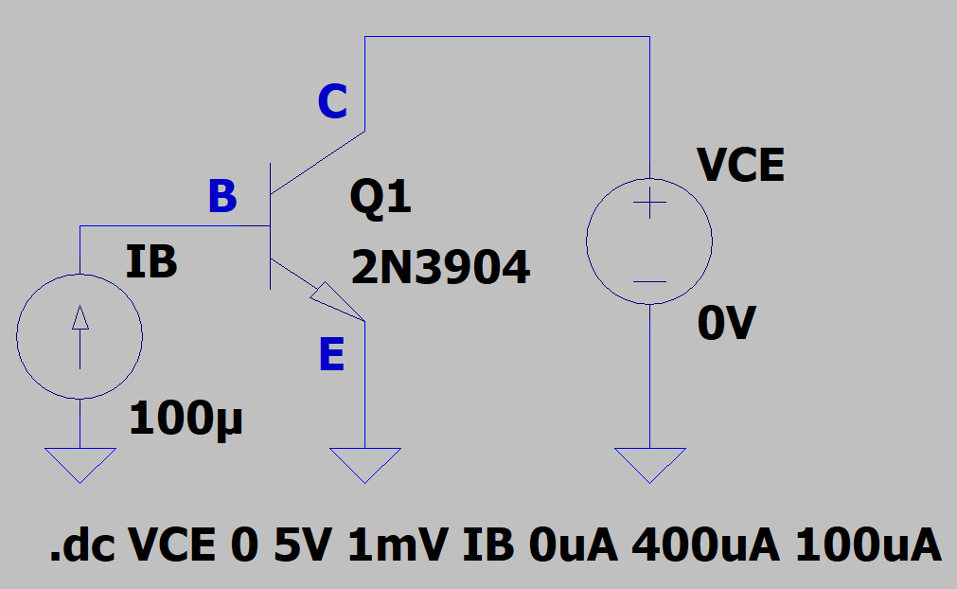
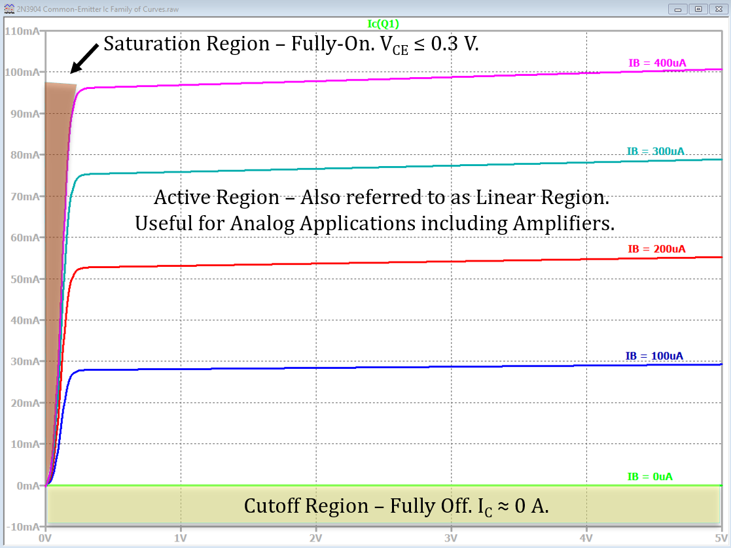
npn Common-Emitter (CE) I-V Characteristics (Continued)
Collector current I_{C} versus increasing Collector-Emitter
voltage V_{CE} has the adjacent characteristic, where each trace
represents a different base current I_{B}.
Zero base current I_{B} means that the Base-Emitter junction is not forward biased resulting in the transistor appearing as an open switch between the Collector and Emitter. This region of operation is referred to as cutoff.
The region of operation with near vertically increasing I_{C} is referred to a saturation, and corresponds to small V_{CE} voltages.
While transistor characteristic curves are shown as discrete traces, operating at any point between traces is a possible with appropriate bias conditions.

Slide 16
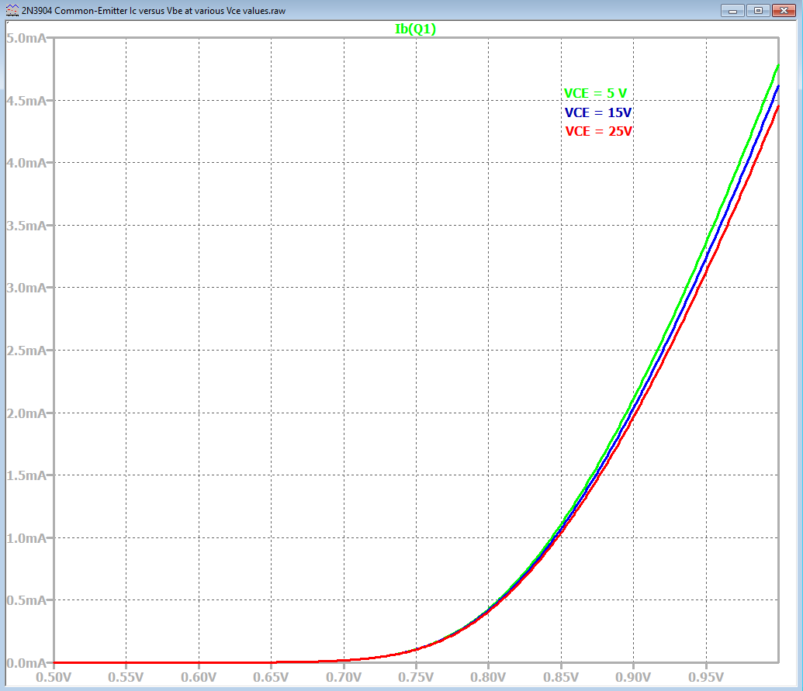
npn Common-Emitter (CE) I-V Characteristics Summary
In the active region the Base current I_{B} is fairly
independent of Collector-to-Emitter voltage as shown
in adjacent graph.
Hence, since I_{C} = βI_{B}, in the active region, Collector current is
also fairly independent of Collector-to-Emitter voltage.
Collector current versus Collector-to-Emitter voltage
for several different Base current values results in
the family of I_{C} versus V_{CE} curves shown below.
Three regions of operation, i.e. cutoff,
active and saturation, are illustrated in
the adjacent family of curves.
Saturation occurs when the Base-
Emitter junction is forward biased and the
Base-Collector junction becomes slightly
forward biased at V_{BC} ≥ 0.4 V, corresponding
to V_{CE} ≤ 0.3 V, for V_{BE} = 0.7 V.

Slide 17
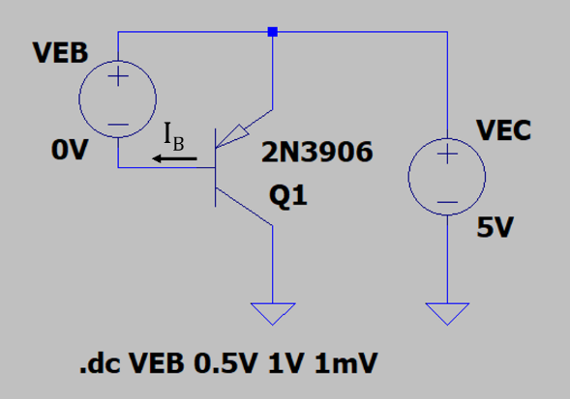
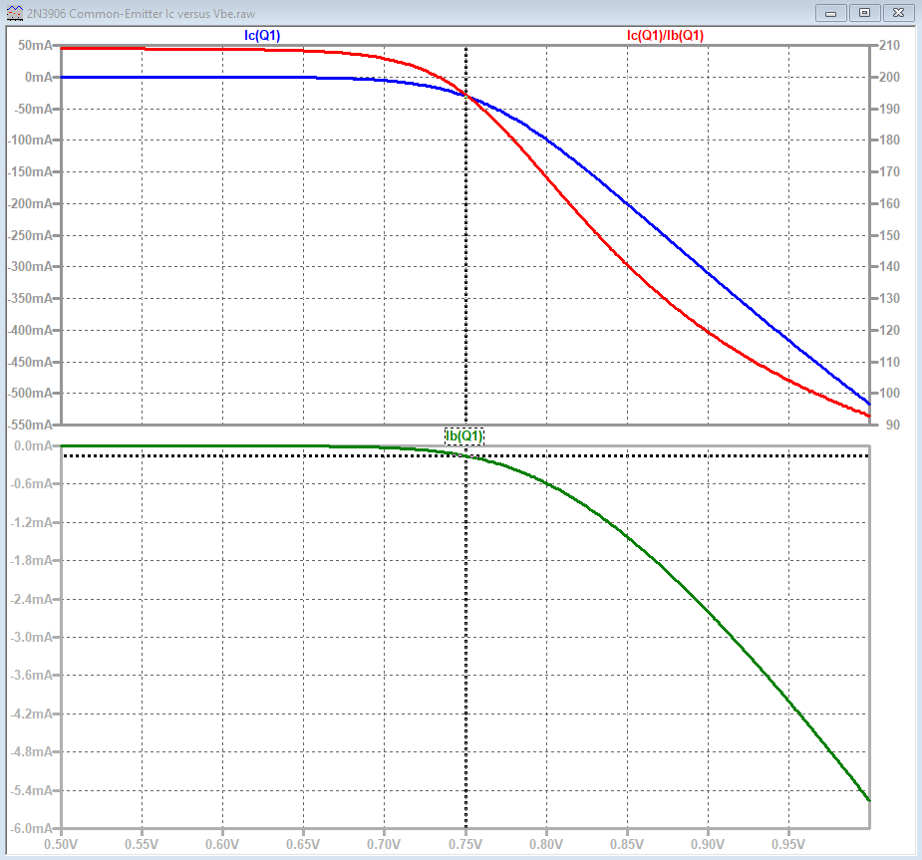
pnp Common-Emitter (CE) I-V Characteristics
Emitter is connected to the positive dc supply
voltage, which is considered an ac ground for
ac amplifiers, i.e. common emitter (CE) configuration.
Base current I_{B} versus Emitter-Base voltage V_{EB} has a
pn junction diode characteristic.
Collector current magnitude |I_{C}| is much larger than Base
current magnitude, because the overwhelming number of
minority carriers injected into the base region end up in the
Collector.
Red trace in the above graph is the I_{C}/I_{B} ratio, i.e. the current gain β of the transistor, with axis on the far right.
By convention, SPICE denotes conventional currents as negative when they flow out of a terminal. Hence, the Base current I_{B} is a negative quantity in the plot because conventional I_{B} flows out of the Base terminal .

Slide 18
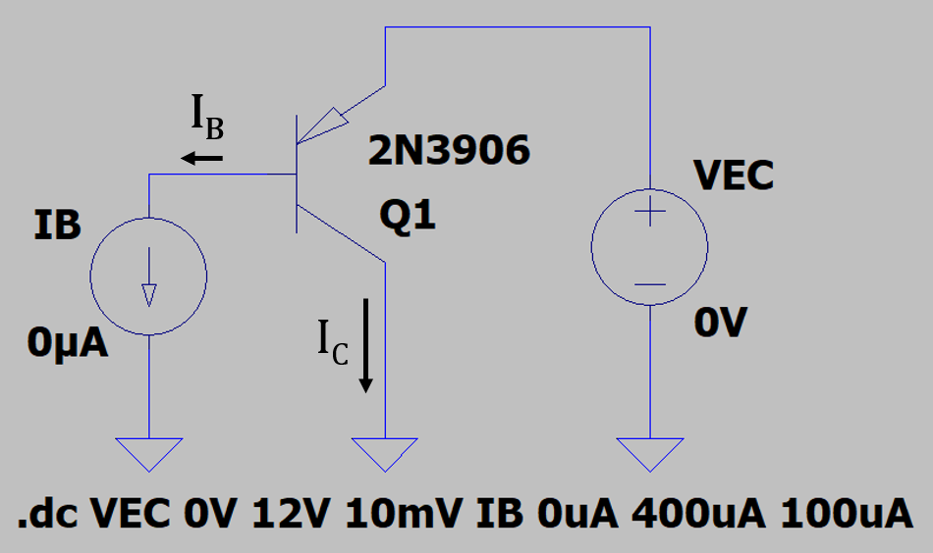
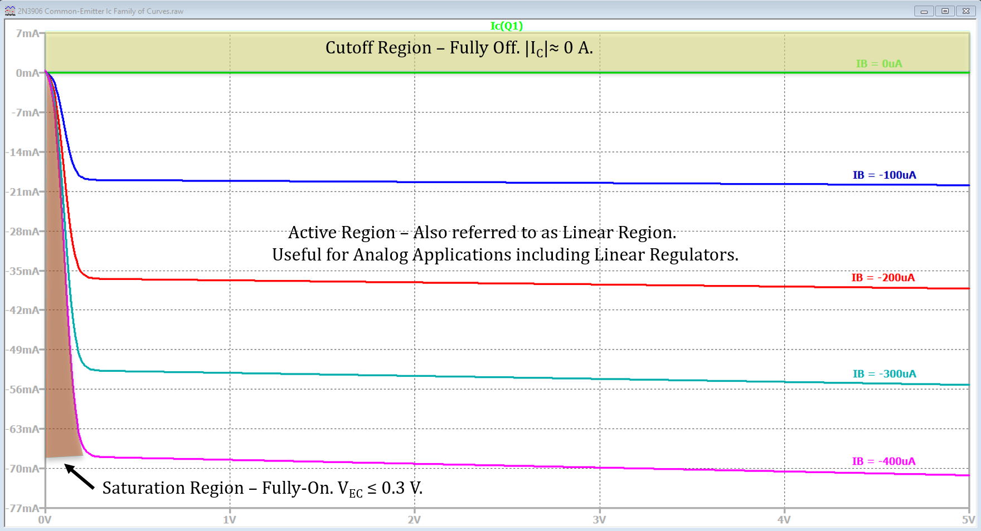
pnp Common-Emitter (CE) I-V Characteristics (Continued)
Collector current I_{C} versus increasing Emitter-Collector
voltage V_{EC} has the adjacent characteristic, where each trace
represents a different base current I_{B}.
Zero base current I_{B} means that the Emitter-Base junction is not forward biased resulting in the transistor appearing as an open switch between the Emitter and Collector. This region of operation is referred to as cutoff.
The region of operation before the leveling off of I_{C} after the “knee” is referred to a saturation, and corresponds to small V_{EC} voltages.
By convention, SPICE denotes conventional currents as negative when they flow out of a terminal. Hence, the Collector current I_{C} is a negative quantity in the above family of curves because I_{C} flows out of the Collector terminal to ground.

Slide 19
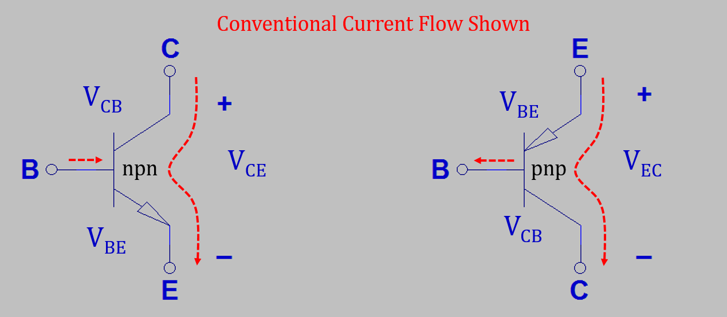
Bipolar Junction Transistor Symbols
Arrowhead defines the direction of conventional current flow at the emitter terminal.
Need V_{BE} ≈ 0.7 V for an npn and ≈ -0.7 V for a pnp, in order to forward bias the Base-Emitter junction, else the transistors are operating in the cutoff region.
For active region operation need Base-Emitter junctions forward biased and Collector-Base junctions reverse biased.
For Saturation need Base-Emitter junctions forward biased, with V_{CE} ≤ 0.3 V for an npn with V_{EC} ≤ 0.3 V for a pnp, i.e., slightly forward biased Collector-Base Junctions.

Slide 20
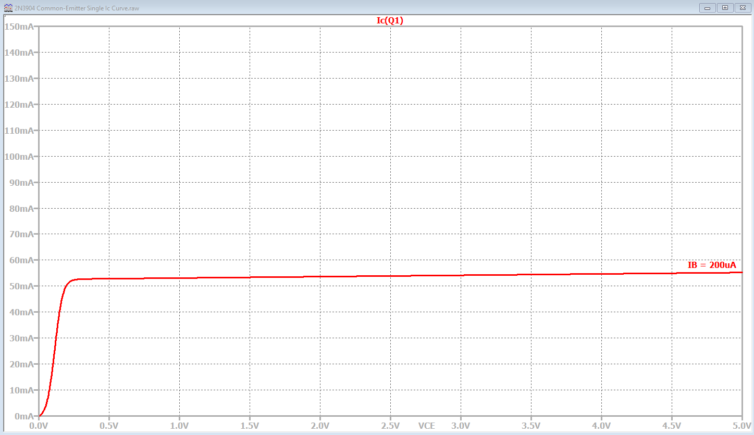
BJT Active and Saturation Regions
The collector current in BJT active region is almost entirely determined by the transistor base current, with V_{CE} having only a slight effect..
BJTs act like a current controlled current source in the active (Linear) region, i.e., I_{C} = βI_{B}.
The load lines below illustrate that
collector current is almost entirely
independent of V_{CE} in the active region.
This results in I_{C} = βI_{B}, which is a
linear equation, resulting in the active
region also referred to as the linear
region of operation.
Since usually β > 50, a small change
in I_{B} results in a much larger change in
I_{C}, which can be utilized to produce
a large voltage gain in an amplifier
circuit.
BJT Saturation Region can
be approximated as a vertical
I_{C} Line at V_{CE} ≤ 0.3 V.
BJT Active or Linear Region can
be approximated as a horizontal
I_{C} Line, acting as a Current Source.
Active
Region
Load Lines

Slide 21
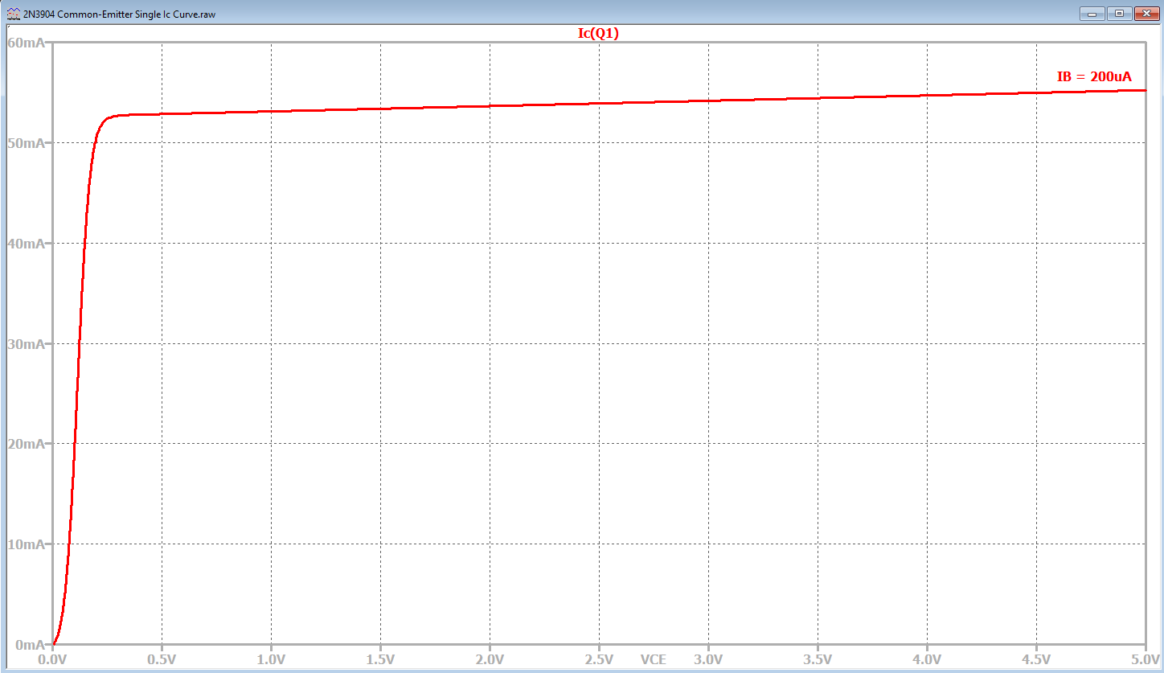
BJT Active and Saturation Regions (Continued)
The collector current in BJT saturation
is mostly determined by external
circuitry, as illustrated by load lines.
Our author refers to the maximum
load-line current as the saturation
current.
The maximum load-line current is
determined by external circuitry, and
not the transistor.
Hence, in the BJT Saturation Region,
the collector current approximately
equals the maximum load-line current.
We will refer to this as circuit
saturation, to be distinguished from
a region of operation of MOSFETs
termed saturation, which is a transistor
saturation of the current.
BJT Saturation Region can
be approximated as a vertical
I_{C} Line at V_{CE} ≤ 0.3 V.
BJT Active or Linear Region can
be approximated as a horizontal
I_{C} Line, acting as a Current Source.
Active
Region
Load Lines

Slide 22

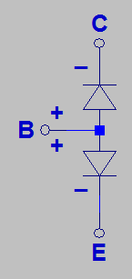
BJT Saturation
Both junctions becoming forward biased, i.e. saturation, resulting in an increase in base current and decrease in β.
In the BJT Saturation Region,
the collector current approximately
equals the maximum load-line current,
i.e. circuit saturation.
β decreases in saturation compared
with active region value, with β_{min} = 10
being a conservative estimate, sometimes
referred to as hard saturation.
Operating a BJT in saturation is
common for digital applications and
undesirable for analog applications.
npn Schematic Symbol
npn diode Equivalent Circuit
BJT Saturation Region can
be approximated as a vertical
I_{C} Line at V_{CE} ≤ 0.3 V.
Active
Region
BJT Active or Linear Region can
be approximated as a horizontal
I_{C} Line, acting as a Current Source.
Load Lines

Slide 23
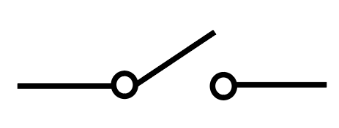
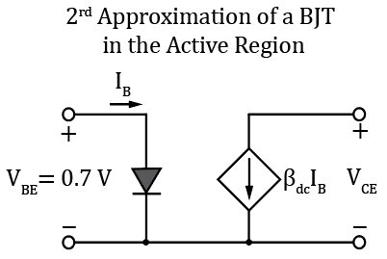
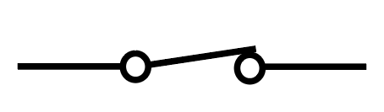
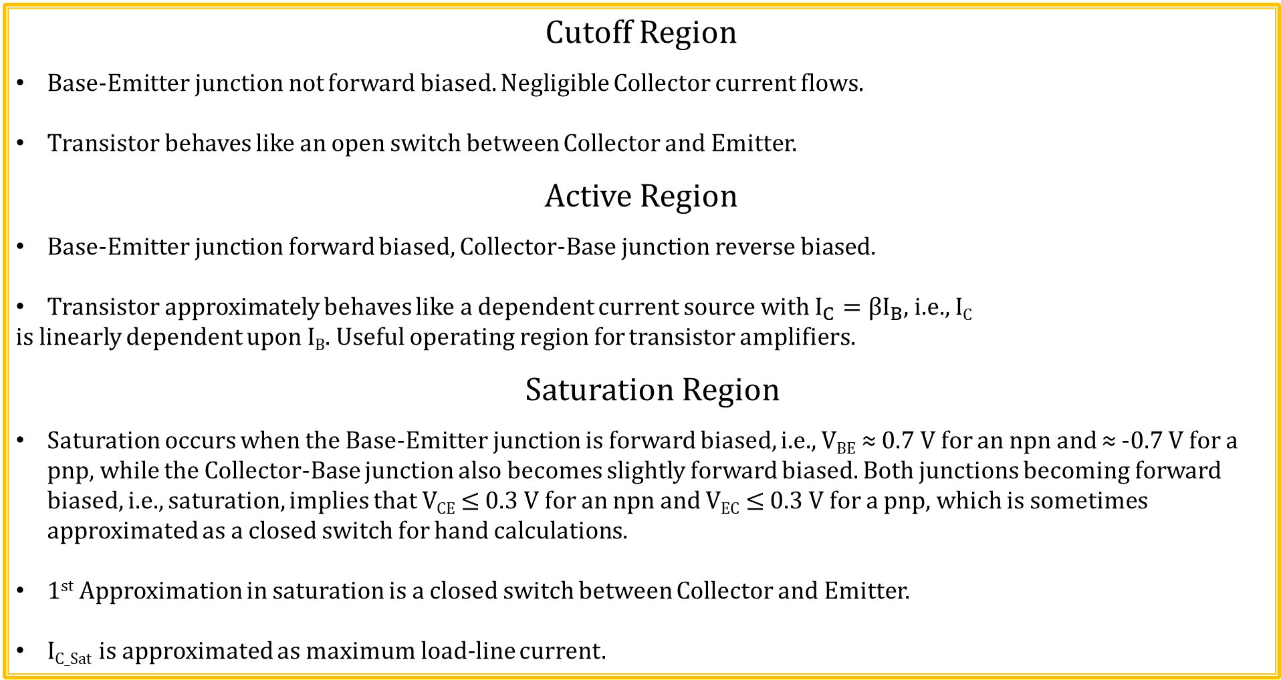
BJT Operating Regions
Cutoff Region
Base-Emitter junction not forward biased. Negligible Collector current flows.
Transistor behaves like an open switch between Collector and Emitter.
Active Region
Base-Emitter junction forward biased, Collector-Base junction reverse biased.
Transistor approximately behaves like a dependent current source with $I_{C}={βI}_{B}$, i.e., I_{C}
is linearly dependent upon I_{B}. Useful operating region for transistor amplifiers.
Saturation Region
Saturation occurs when the Base-Emitter junction is forward biased, i.e., V_{BE} ≈ 0.7 V for an npn and ≈ -0.7 V for a pnp, while the Collector-Base junction also becomes slightly forward biased. Both junctions becoming forward biased, i.e., saturation, implies that V_{CE} ≤ 0.3 V for an npn and V_{EC} ≤ 0.3 V for a pnp, which is sometimes approximated as a closed switch for hand calculations.
1st Approximation in saturation is a closed switch between Collector and Emitter.
I_{C_Sat} is approximated as maximum load-line current.
Poll Questions.

Slide 24
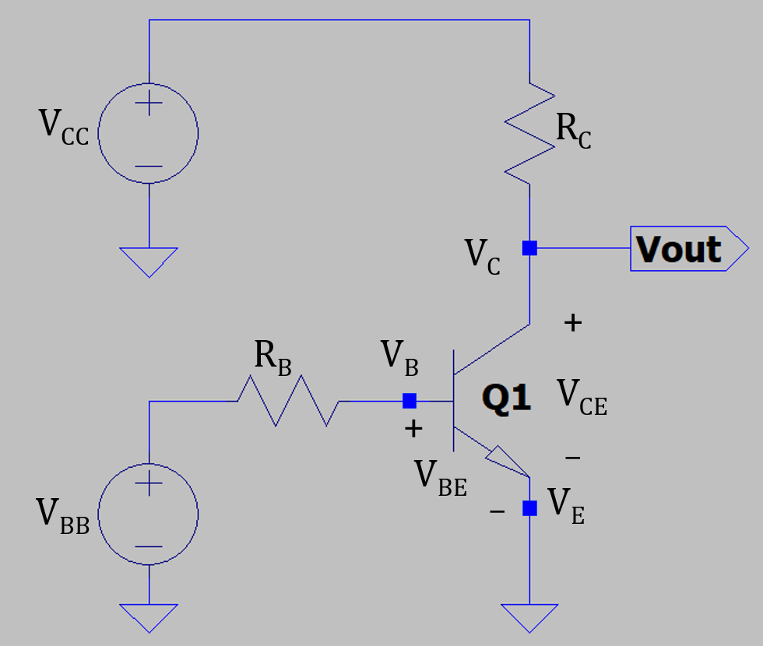

Common-Emitter (CE) Configuration
Common-emitter (CE) configuration refers to the emitter terminal being connected to the ground or common
terminal of the power supplies. The adjacent circuit is connected to a dc
ground, although CE configuration also results from emitter connected to
an ac ground for ac amplifiers, as will be discussed at a future time.
Subscript Notation:
Single subscripts are used for node voltages, i.e., V_{B}, V_{C} and V_{E}.
Double subscripts are used to represent either sources of power,
such as V_{CC} or V_{BB}, and also the voltage between two different nodes
such as V_{CE} = V_{C} – V_{E}.
Output voltage V_{out} also equals collector node voltage V_{C} = V_{CE} in the
adjacent schematic.
In the above circuit, 2nd approximation implies that Q1 is operating in cutoff
if V_{BE} < 0.7 V.
Q1 is operating in the active region for V_{BE} ≥ 0.7 V and V_{CE} > 0.3 V.
Q1 is operating in the saturation region for V_{BE} ≥ 0.7 V and V_{CE} ≤ 0.3 V.

Slide 25
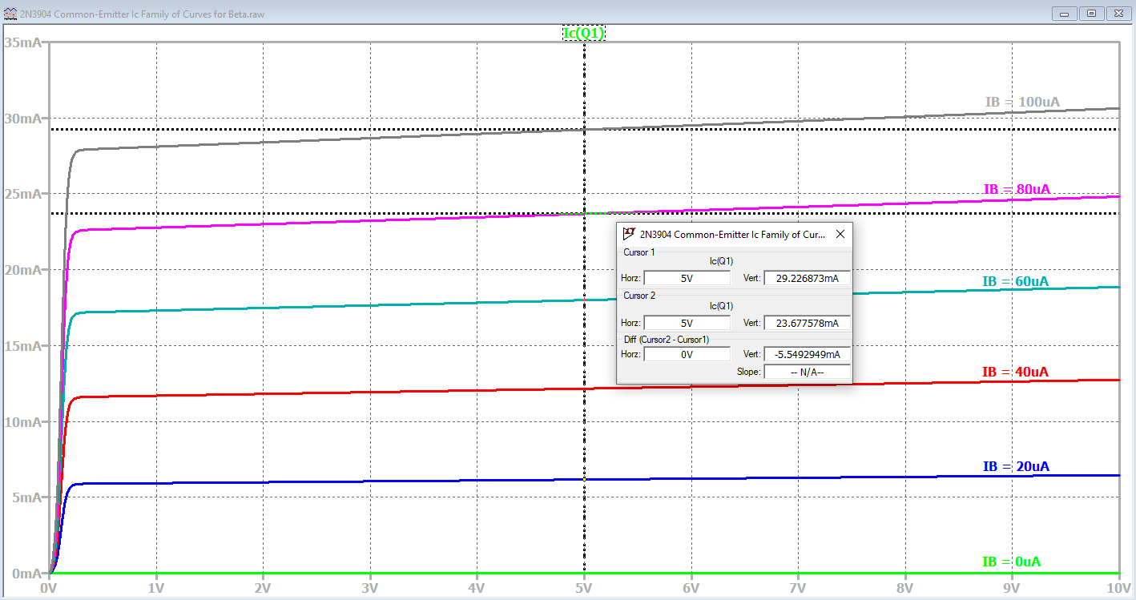
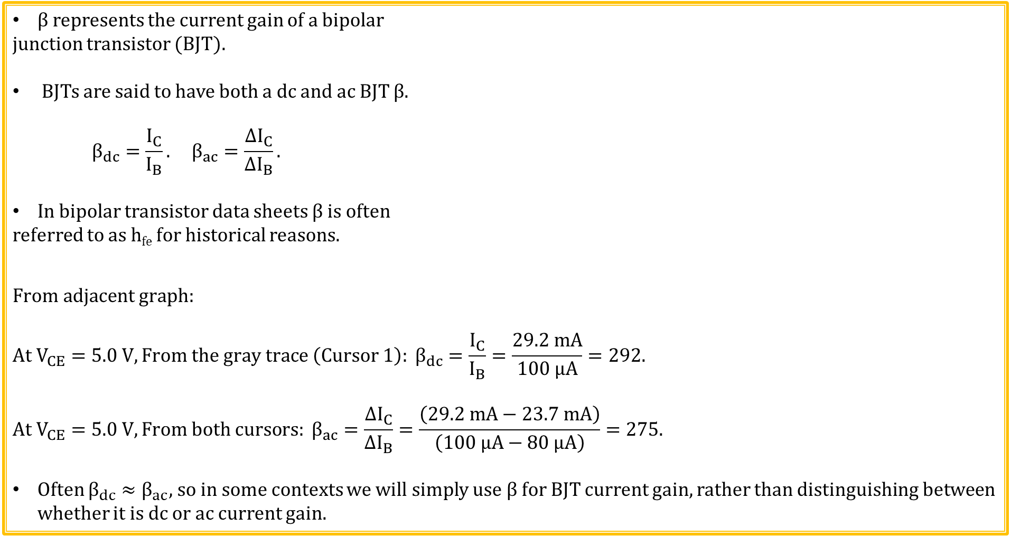
β – BJT Current Gain
β represents the current gain of a bipolar
junction transistor (BJT).
BJTs are said to have both a dc and ac BJT β.
$$β_{dc}=\frac{I_{C}}{I_{B}}. β_{ac}=\frac{{∆I}_{C}}{{∆I}_{B}}.$$
In bipolar transistor data sheets β is often
referred to as h_{fe} for historical reasons.
$$From adjacent graph:$$
$$At V_{CE}=5.0 V, From the gray trace \left(Cursor 1\right): β_{dc}=\frac{I_{C}}{I_{B}}=\frac{29.2 mA}{100 μA}=292.$$
$${At V_{CE}=5.0 V,From both cursors: β}_{ac}=\frac{{∆I}_{C}}{{∆I}_{B}}=\frac{\left(29.2 mA−23.7 mA\right)}{\left(100 μA−80 μA\right)}=275.$$
Often $β_{dc}≈β_{ac}$, so in some contexts we will simply use β for BJT current gain, rather than distinguishing between whether it is dc or ac current gain.

Slide 26
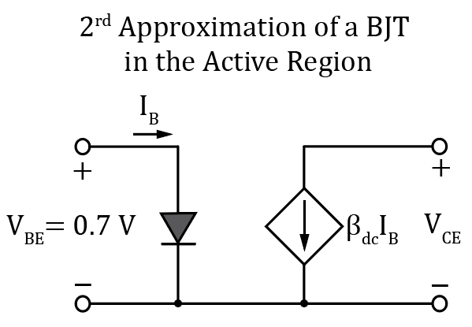
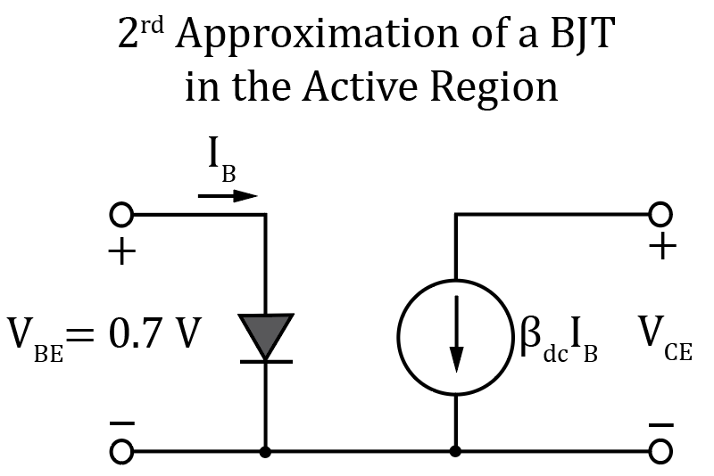
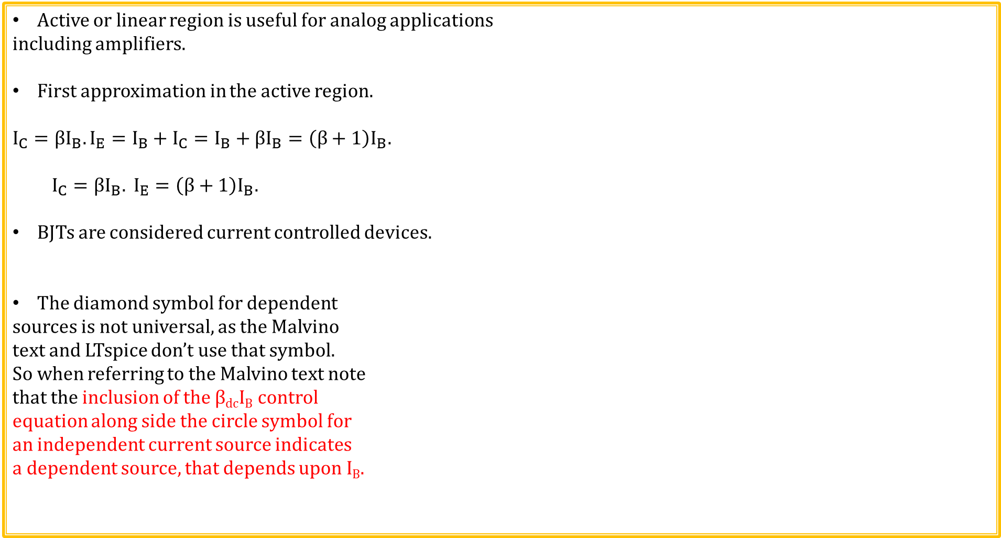
Transistor Approximations
Active or linear region is useful for analog applications
including amplifiers.
First approximation in the active region.
$$I_{C}=βI_{B}. I_{E}=I_{B}+I_{C}=I_{B}+βI_{B}=\left(β+1\right)I_{B}.$$
$I_{C}=βI_{B}. I_{E}=\left(β+1\right)I_{B}.$
BJTs are considered current controlled devices.
The diamond symbol for dependent
sources is not universal, as the Malvino
text and LTspice don’t use that symbol.
So when referring to the Malvino text note
that the inclusion of the β_{dc}I_{B} control
equation along side the circle symbol for
an independent current source indicates
a dependent source, that depends upon I_{B}.

Slide 27
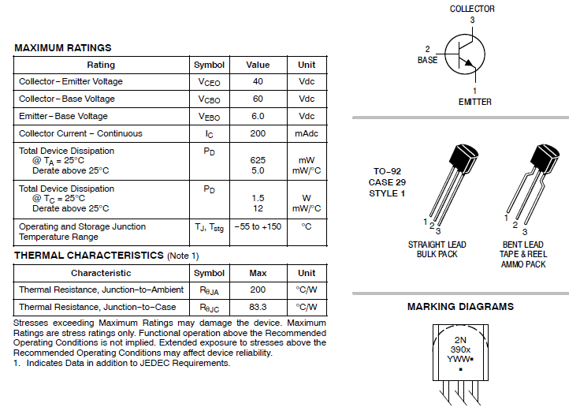
2N3904 npn BJT Data Sheet

Slide 28
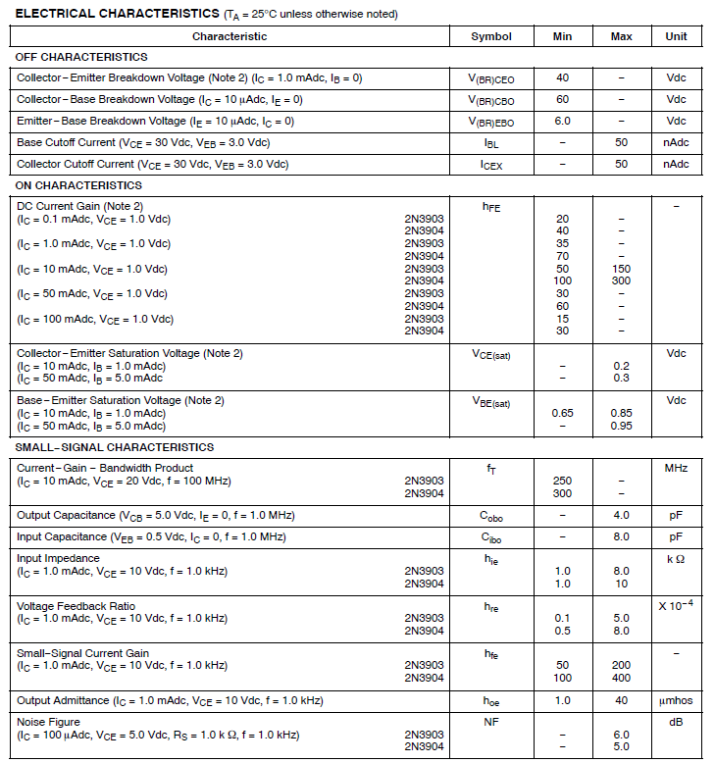
2N3904 npn BJT Data Sheet (Continued)

Slide 29
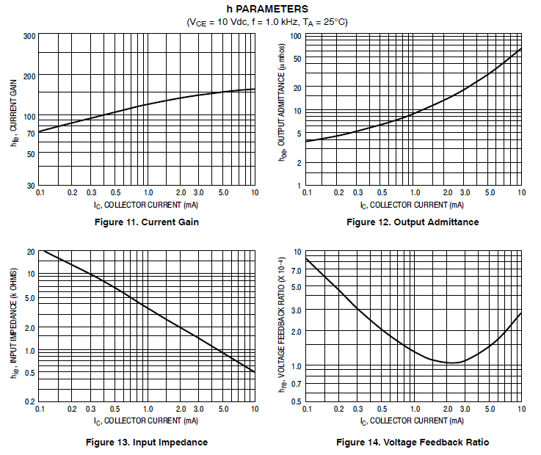
2N3904 npn BJT Data Sheet (Continued)

Slide 30
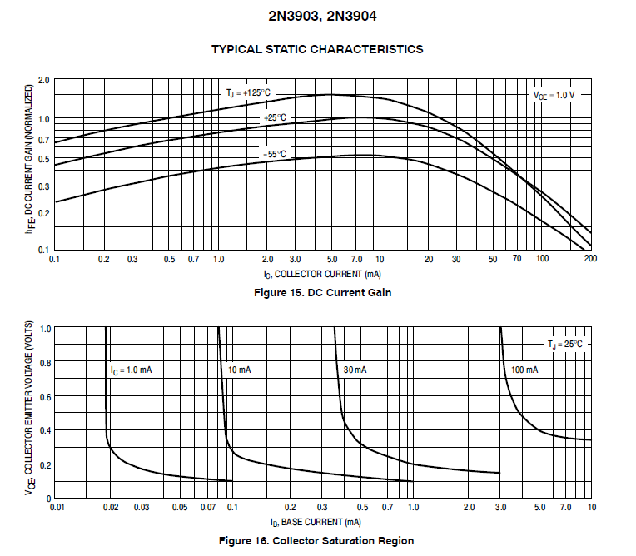
2N3904 npn BJT Data Sheet (Continued)

Slide 31
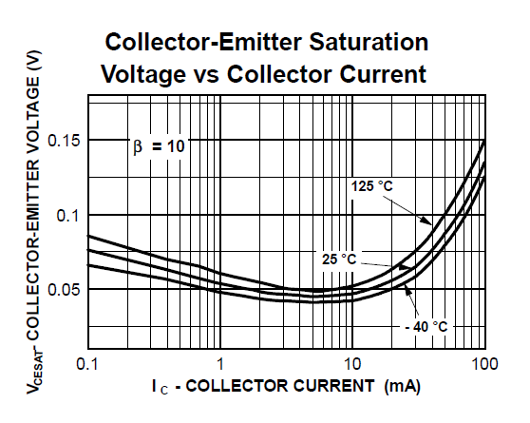
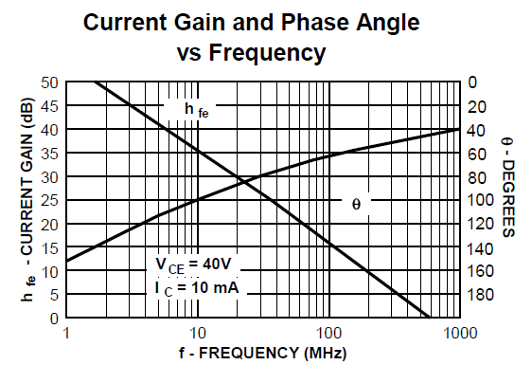
2N3904 npn BJT Data Sheet (Continued)

Slide 32
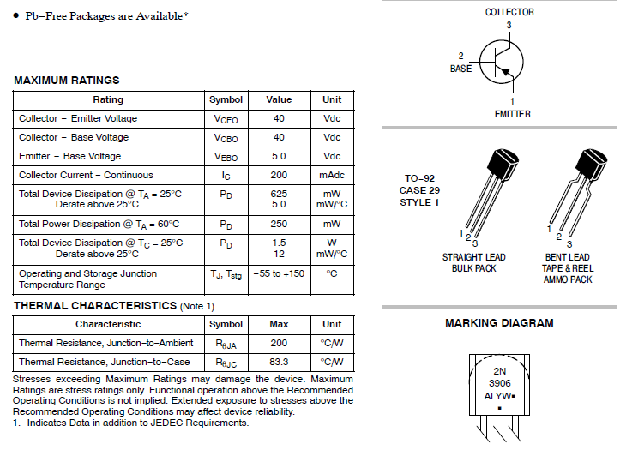
2N3906 pnp BJT Data Sheet

Slide 33
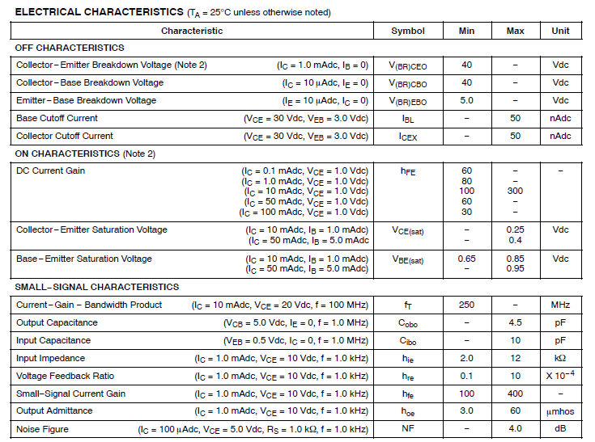
2N3906 pnp BJT Data Sheet (Continued)

Slide 34
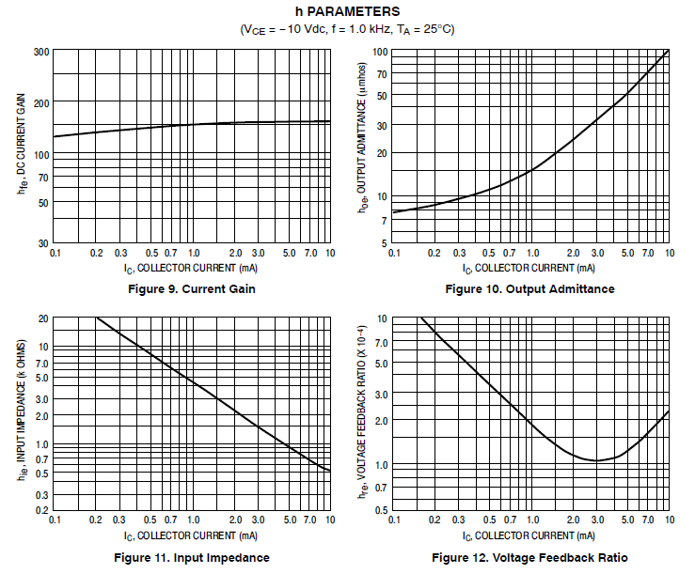
2N3906 pnp BJT Data Sheet (Continued)

Slide 35
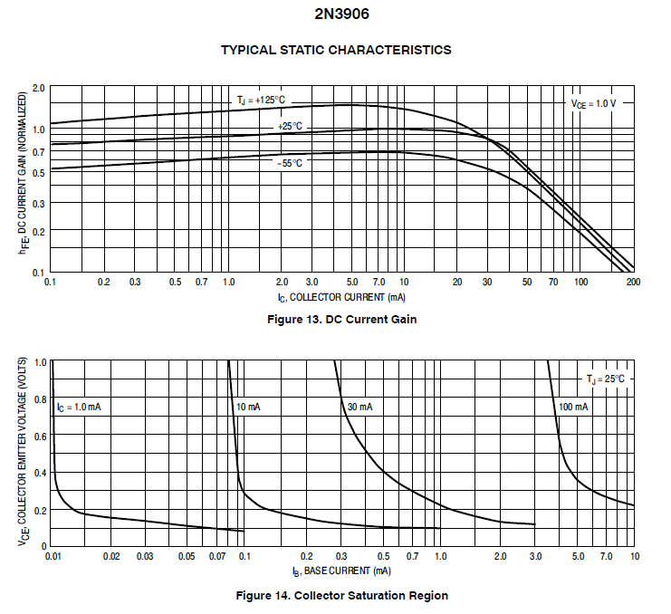
2N3906 pnp BJT Data Sheet (Continued)

Slide 36



npn Common-Emitter (CE) Stage
Output is 5.0 V for transistor off, and within 0.3 V of ground for relatively low (< 20 mA) collector current.
Cutoff
Active
Saturation

Slide 37


npn Common-Emitter (CE) Stage (Continued)
Notice that in circuit saturation that increasing base current does not dramatically increase the collector current, i.e., the collector current approaches a saturation value.
Cutoff
Active
Saturation

Slide 38

pnp Common-Emitter (CE) Stage
Emitter is connected to the positive dc supply
voltage, which is considered an ac ground for
ac amplifiers, i.e., common emitter (CE) configuration.
Output is 0.0 V for transistor off, and within 0.3 V of 5.0 V for relatively low (< 20 mA) magnitude collector current.
Saturation
Active
Cutoff

Slide 39


pnp Common-Emitter (CE) Stage (Continued)
Notice that in circuit saturation that increasing the magnitude of the base current does not dramatically increase the magnitude of the collector current, i.e., the collector current magnitude approaches a saturation value.
Saturation
Active
Cutoff

Slide 40


Load Line for Common-Emitter (CE) Configuration
For hand calculations, the load line provides helpful approximations
for determining the saturation and cutoff points of a given circuit.
Look at end-point extremes for I_{C_Sat} and V_{CE_Cutoff}:
For V_{out} = V_{CE} = 0 V, I_{C_Max}, i.e. I_{C_Sat} = V_{CC}/R_{C} = (10 V)/(400 Ω) = 25 mA.
For I_{C} = 0 A, V_{CE} = V_{CC} = 10 V.
Superimpose the resulting load line over the
transistor characteristics.
The actual transistor operating point must lie on
the load line.
While discrete I_{C} versus V_{CE} lines are shown, I_{C}
can take on any value between the discrete lines,
given the appropriate I_{B} value.
Saturation
Point
Cutoff
Point

Slide 41


npn Common-Emitter (CE) LED Driver
Design an npn common-emitter LED driver with base bias such as shown in the
adjacent 5 V powered circuit.
Based on lab measurements, a red LED takes ≈ 3 mA at 1.7 V for good brightness.
Want I_{C_Sat} ≥ 3 mA. Choose $\text{I}\text{C}\text{_}\text{Sat}\text{ = 3.3 }\text{mA}\text{. 3.3 }\text{mA}=\frac{5 V − 1.7 V}{R2}.$
$R2=\frac{5 V −1.7 V}{3.3 mA}=1 kΩ.$ Choose $R2=1 kΩ.$
The above calculation assumed negligible V_{CE}, implying saturation region.
From 2N3904 characteristics, β_{min} = 70 for 1 mA in active region, yet β is reduced in
saturation. So assume β_{min} = 10 for 3.3 mA in hard saturation, which is conservative
but provides a robust design.
So need I_{B} ≥ (3.3 mA)/10 ≥ 330 µA. $\text{I}\text{B}\text{ =}\frac{V_{i} − 0.7 V}{R1}$. V_{i} = 5 V max.
$R1≤\frac{5 V − 0.7 V}{330 μA}≤$ 13.0 kΩ. Choose $R1=13 kΩ.$
For R1 = 13 kΩ and R2 = 1 kΩ, a 2N3904 npn transistor should be able to turn on a Red LED, like the one characterized in the Zener Diodes and LED lab, when powered by a 5 V supply.
Poll Questions
You need to do similar calculations for the upcoming homework.

Slide 42

Ideal Voltage Follower
What is V_{out} and why in the adjacent circuit?
V_{p} = V_{in}. V_{out} = V_{m}.
Also, V_{p} = V_{m}. Therefore V_{out} = V_{in}.
Why does V_{p} = V_{m}?
Because of large open-loop voltage gain and negative feedback, V_{out} is always adjusts V_{m} towards V_{p}.
The only time that V_{out} is not adjusting V_{m} towards V_{p}, is when V_{m} = V_{p}, which implies
V_{out} = V_{in}. Hence, V_{out} follows V_{in}.
If V_{out} became < V_{in}, then V_{p} > V_{m}, resulting in V_{out} increasing until V_{m} again equals V_{p}.
If V_{out} became > V_{in}, then V_{p} < V_{m}, resulting in V_{out} decreasing until V_{m} again equals V_{p}.
Since V_{out} = V_{in}, the resulting voltage gain with feedback, i.e. closed-loop gain = 1 because of negative feedback, whereas open-loop gain >> 1.

Slide 43

Buffered Op-Amp Using BJT Emitter Follower
For the adjacent circuit, what is V_{out}?
Because op-amp output adjusts the base-to-emitter
voltage of the BJT until the BJT collector current I_{c} multiplied
by Rload = V_{in}, i.e., the output voltage is regulated over a wide
range of load resistance values, termed a Voltage Regulator.
Voltage Regulators may need to provide more than 1 A of
output current.
BJT source-follower in above circuit increases output current well beyond the 10 to 20 mA possible from the op-amp output. The npn transistor boosts the current well beyond what the op-amp can provide.
One weakness of the above circuit occurs if/when the output is inadvertently shorted to ground, which is easy to do.
If V_{CC} is a stiff voltage supply and V_{out} is inadvertently shorted to ground, then transistor Q1 will likely overheat and be destroyed.
Practical voltage regulators provide some method of limiting the output current so as to protect the output transistor.

Slide 44




Output Protection for Stiff Voltage Sources
The adjacent practical voltage source can be
modeled as a Thevenin equivalent circuit.
Stiff Voltage Source: R_{s} < 0.01R_{load}.
Large and damaging currents can flow from
inadvertently shorted stiff voltage source without some type of current limiting.
For example, a healthy 12 V lead-acid battery can provide over 400 A for
several seconds, as needed to start cars. Inadvertently shorting across the
terminals of a 12 V lead-acid battery, i.e. a load fault, will damage or destroy
diodes and switching transistors, along with PCB traces.
A circuit that is easily destroyed by a simple load fault is not a good, robust design.
One-time blowable fuses protect the wiring and circuitry, and are commonly
employed in automobiles. Yet replacing fuses is considered too cumbersome
for many electronic applications, and so instead recoverable current limit
circuitry is often employed to protect wiring and circuitry.
A good, robust design can withstand common user errors and load faults.

Slide 45


V_{BE} Current Limit Circuit
The adjacent circuit is a 5 V voltage regulator, i.e.,
stiff 5 V voltage source, with V_{BE} current limit.
Under normal load conditions, V_{out} = 5 V, with Q1 operating in
cutoff, having no effect on V_{out}.
Yet when (I_{load})(R_{cl}) exceeds approximately 0.6 V, Q1 begins
turning on and diverts base current from transistor Q2, which
then limits the Q2 emitter current to approximately (0.66 V)/R_{cl}.
The 2nd approximation of V_{BE} = 0.7 V for transistor turn on
results in a calculated current limit that is too large by more
than 10%, so we will be using V_{BE} = 0.66 V for current limit
calculations for both npn and pnp V_{BE} current limit circuits.
For example with R_{cl} = 4.3 Ω, I_{lim} ≈ (0.66 V)/(4.3 Ω) = 154 mA.
Whereas, maximum load current for the above circuit is
simulated at approximately 142 mA (-8% from calculated I_{lim}).
Output Transistor

Slide 46
V_{BE} Current Limit Circuit (Continued)
When in regulation the output of op-amp U1 controls the base current
of Q2 so as to maintain an output voltage of 5.0 V, over a wide range of
load currents.
The parts cost for the adjacent V_{BE} current limit circuitry
is less than 10 cents in production quantities.
What is the output voltage V_{out}, when the current limit is activated?
V_{out} = (I_{lim})R_{limit}, which is less than the desired 5 V. We say that
the voltage regulator has come out of regulation when operating
in current limit, with the output voltage becoming a function of
load current.
Another point of view is that the voltage regulator, which is a
voltage source, turns into a current regulator, or current source,
upon entering current limit.
A current limit is much more convenient than a 1-time
blowable fuse for circuit protection.

Slide 47
Transistor Approximations
Active or linear region is useful for analog applications
including amplifiers.
First approximation in the active region.
$$I_{C}=βI_{B}. I_{E}=I_{B}+I_{C}=I_{B}+βI_{B}=\left(β+1\right)I_{B}.$$
$I_{C}=βI_{B}. I_{E}=\left(β+1\right)I_{B}.$
BJTs are considered current controlled devices.
The diamond symbol for dependent
sources is not universal, as the Malvino
text and LTspice don’t use that symbol.
So when referring to the Malvino text note
that the inclusion of the β_{dc}I_{B} control
equation along side the circle symbol for
an independent current source indicates
a dependent source, that depends upon I_{B}.

Slide 48

BJT Circuit Debug/Testing
With a DMM, verify that V_{BE} is approximately |0.7 V| for active region operation.
Use portable DMM β (h_{fe}) test socket.
May have to put pressure on BJT package for good
reading.

Slide 49
ECEN 350 – Topics
Semiconductor Physics
IC Op-Amps
Rectifiers
Zeners
Diodes
BJTs
MOSFETs
CMOS
LEDs
Transistor Biasing
Small-Signal Analysis
Amplifier Gain Stages
Frequency Response

Slide 50
The End

Slide 51
Extra

Slide 52

BJT Transistor Relationships
$$α=\frac{I_{C}}{I_{E}}. β=\frac{I_{C}}{I_{B}}. I_{E}=I_{B}+I_{C}.$$
$$I_{C}={βI}_{B}. I_{E}=I_{B}+I_{C}=I_{B}+{βI}_{B}. I_{E}={\left(β+1\right)I}_{B}.$$
$$I_{C}={βI}_{B}. I_{E}={\left(β+1\right)I}_{B}.$$
BJT analysis approach is to first find I_{B}, the solve for I_{C}, and I_{E}.
$$α=\frac{I_{C}}{I_{E}}=\frac{{βI}_{B}}{I_{E}}=\frac{{βI}_{B}}{I_{B}+I_{C}}=\frac{{βI}_{B}}{\left(1+\frac{I_{C}}{I_{B}}\right)}=\frac{β}{1+β}=\frac{β}{β+1}.$$
$$α=\frac{β}{β+1}.$$
$$β=\frac{I_{C}}{I_{B}}=\frac{{αI}_{E}}{I_{E}−I_{C}}=\frac{α}{\left(1−\frac{I_{C}}{I_{E}}\right)}=\frac{α}{\left(1−α\right)}.$$
$$β=\frac{α}{α−1}.$$

Slide 53
Test Time – Just for Fun. No Points.

Slide 54
BJT Test
What is largest current in a bipolar transistor operating in the active region?
1. Emitter Current.
2. Base Current.
3. Collector Current.
Answer: 1. Emitter Current since I_{E} = I_{C} + I_{B}.

Slide 55
BJT Test (Continued)
The arrow in the transistor symbol defines the direction of conventional current flow for which of the following terminals?
1. Emitter.
2. Base.
3. Collector.
Answer: 1. Emitter, which then also defines the direction for base and collector currents since I_{E} = I_{C} + I_{B}.

Slide 56

BJT Test (Continued)
Choose the best answer for reasonable $α$_{dc} values for a bipolar junction transistor operating in the active region.
1. 0.7.
2. 0.96.
3. 1.1.
4. ≥ 10.
Answer: 2. $α=\frac{I_{C}}{I_{E}}$ ≈ 1, but < 1.1.

Slide 57
BJT Test (Continued)
In the active region of a bipolar transistor what are the bias conditions
for the Base-Emitter and Collector-Base junctions?
1. Forward, Forward.
2. Forward, Reverse.
3. Reverse, Forward.
4. Reverse, Reverse.
Answer: 2. Base-Emitter forward biased and Collector-Base junction
reverse biased for active region.

Slide 58
BJT Test (Continued)
As a 2nd approximation for hand calculations, the base-to-emitter voltage of a bipolar junction transistors operating in the saturation or active regions can be assumed to be what voltage?
1. 0.0 V.
2. 0.3 V.
3. 0.7 V.
4. Not enough information.
Answer: 3. 0.7 V.

Slide 59
BJT Test (Continued)
Is the following transistor symbol for an npn or pnp transistor?
1. npn.
2. pnp.
Answer: 2. pnp transistor since arrow is pointing in, whereas
the arrow in an npn transistor is not pointing in.

Slide 60
BJT Test (Continued)
What is smallest current in a bipolar transistor operating in the active region?
1. Emitter Current.
2. Base Current.
3. Collector Current.
Answer: 2. Base Current since I_{E} ≈ I_{C} and I_{B} << I_{C}.

Slide 61

BJT Test (Continued)
Choose the best answer for reasonable β_{dc} values for a bipolar junction transistor operating in the active region.
1. 0.7.
2. 0.9 to 1.0.
3. 50 to 400.
4. > 1000.
Answer: 3. $β=\frac{I_{C}}{I_{B}}, with β typically ranging from 50 to 400.$

Slide 62


Buffer Stage Example (Continued)
DMM Measurement Details Lab provided a circuit with a large Thevenin Output impedance/resistance.
The portable DMM’s having 10 MΩ input
impedance/resistance is not high enough for a good
voltage measurement in this particular case.
Need a buffer stage. The VirtualBench High (10 GΩ) Input Impedance setting provided a measured result of approximately 10 V, accomplished by incorporating an internal buffer amplifier having very high input impedance (10 GΩ) so as to not load down the above Thevening Equivalent Circuit. A good buffer also has low output resistance/impedance so that reasonable resistive load does not affect the output voltage.

Slide 63

Common-Emitter Configuration (Continued)
How can this circuit achieve voltage gain?
Small change in I_{b} results in β times larger change in I_{c} in active region.
V_{o} = Vcc – I_{C}Rc.
Output voltage V_{o} decreases for an increase in input voltage V_{i}.
Hence, common-emitter is an inverting stage.

Slide 64

Common-Collector (Emitter-Follower) Configuration
Only the collector voltage is fixed in this configuration, and so referred to as Common-
Collector, even though collector is not necessarily
common between input and output.
Also referred to as emitter-follower since the
emitter terminal follows within approximately
0.7 V of the base terminal.
Large current gain possible although the
maximum voltage gain equals 1.
Emitter follower is a useful buffer stage.
A buffer stage interfaces between a voltage source with a relatively large Thevenin output resistance/impedance and a load requiring a small Thevenin output resistance/impedance.
A good buffer stage requires negligible input current while providing significant output current at the desired output voltage.
Output voltage Vo increases for increasing input voltage Vi.

Slide 65

Buffer Stage Example
DMM Measurement Details Lab provided a circuit with a large Thevenin Output impedance/resistance.
The portable DMM’s having 10 MΩ input
impedance/resistance is not high enough for a good
voltage measurement in this particular case.
Need a buffer stage. An Emitter-Follower stage would help, although
there is still non-negligible base current along with approximately 0.7 V
drop from base-to-emitter.

Slide 66

Common-Base Transistor Configuration
Both input and output terminals share the Base terminal, i.e. Common-Base.
Can achieve voltage gain.
Need to bias the emitter terminal to below ground for active region operation.
Not widely used because of the need of a negative supply voltage.

